Slide 1



Checklist Document

Slide 2

Definitions/Acronyms:
Term/Acronym | Definition
A-SPICE | Automotive Software Process Improvement and Capability Determination
SYS | System Engineering
SWE | Software Engineering
Workflow | Definition, execution and automation of business processes where tasks, information or documents are passed from one participant to another for action, according to a set of procedural rules.
Trace | Link between two meaningful contents in a document

Slide 3
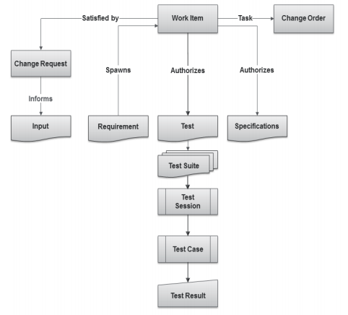
What Are Items?
  Items are the basic building blocks of the Integrity data model, and represent the information assets and process objects associated with software development.
  For example, items can represent Work items, projects, requirements, test cases, change requests, and defects.
  Every item is configurable and contains metadata and history about that item.
  Every item type has its own enforceable workflow which describes how it moves from state to state, complete with definable rules, full audit trails, and security.
  Escalations, conditional assignments, notifications, and external processes can all be defined and initiated as part of Integrity’s process automation

Slide 4
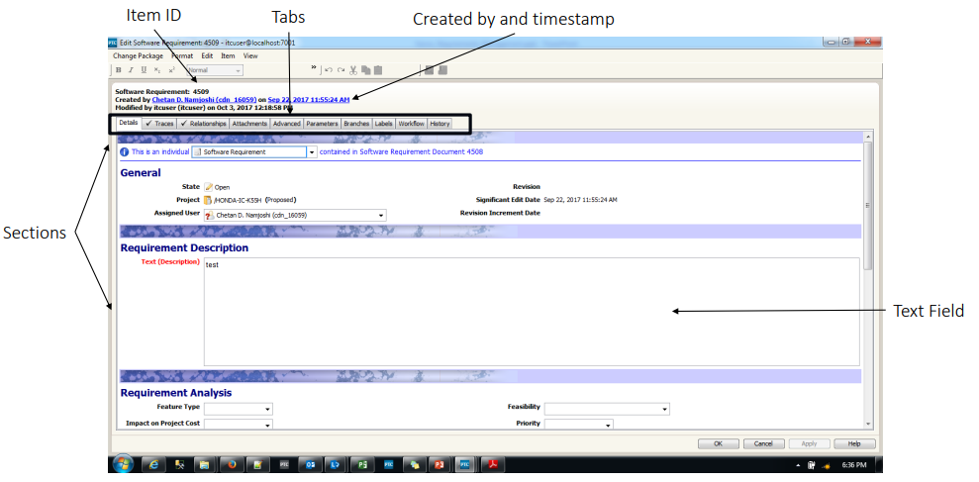
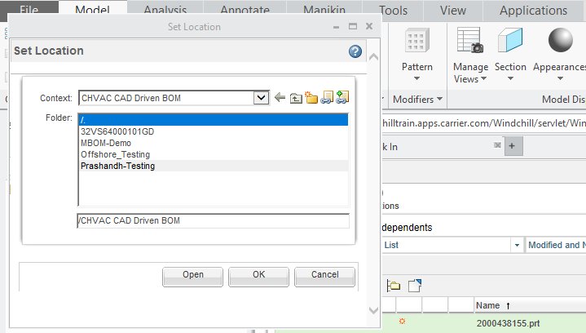
Item Details view
1
2
3
4
5
6

Slide 5
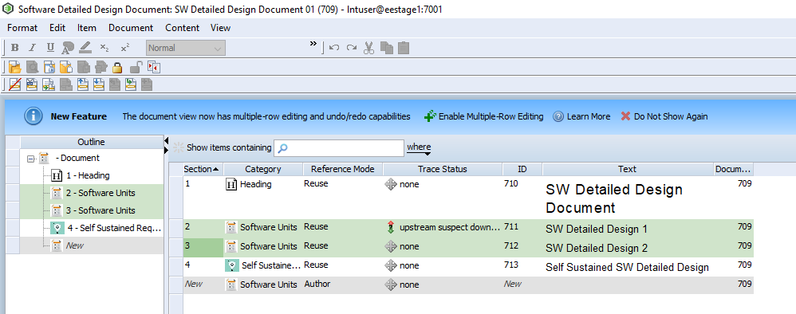
What Is a Document?
Documents are typically used in the requirements management and test management domains.
With the applicable permissions, you can manage all aspects of document and content creation and modification, including creating relationships between content items across and between domains, called trace relationships.
For example, a requirement item could be verified by a test case and that requirement and test case pair could be connected to a larger test suite document using a relationship that collectively verifies a major software change.
The Document view is the interface you use to view
and modify documents and content in a cohesive
tree structure.

Slide 6
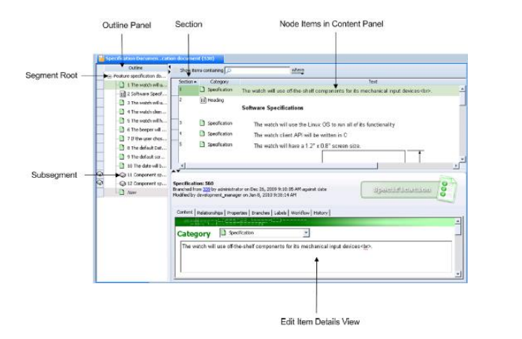
Document View

Slide 7
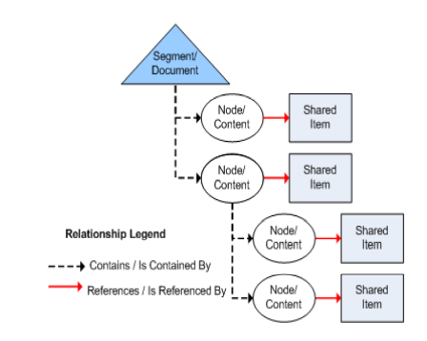
Document Structure
Segment is a root document, the container for all content.
Node is any content within that root document including individual content items and sub-segments
Shared item is the shared content.
A Grouped Hierarchy of nodes in a document, for example: section 1.4 and its children, 1.4.1, 1.4.2 or section 3.4.2 and its children 3.4.2.1, 3.4.2.2.

Slide 8
Finding Documents or Items

Slide 9
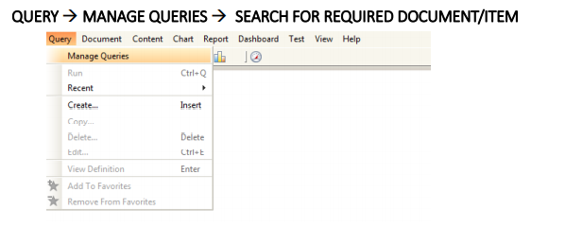
Finding Documents or Items
In order to make it easy for the users, Integrity Client has the functionality to search for documents and Items with the help of query option.
To find any document or item, follow the below steps:
Open Integrity Client.
Select Query in the menu..
In the drop down, select “Manage Queries”.

Slide 10
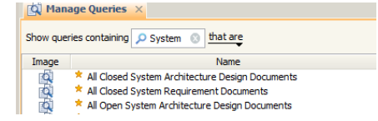
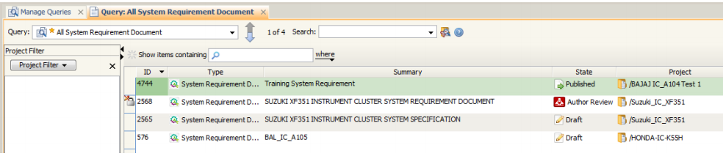
Finding Documents or Items
Selecting Manage Queries will display a list of queries that will assist user in finding the documents based on types and other factors.
For example, if the user wants to look for a System Requirements Document, he/she can search for it using the search bar.
Select “All System Requirement Document” query in order to open the list of System Requirements Documents.
From the displayed list of documents, select the necessary document.

Slide 11

Finding Documents or Items
Integrity also provides an option wherein user can directly search for the Document/Item using its unique ID.
As Item ID for every created content is unique, the search will thus open the required document/item seamlessly.
To search the Document/Item using its Unique Item ID,
Go to the toolbar below menu.
In the search bar with the title as “Item”, type your Item ID and press Enter.
The Document/Item will be displayed.

Slide 12
Baseline
A Baseline is a special label that can only be added to documents. You create a document baseline to mark an important project milestone. For example, you could create document baselines for an approved design document, a legal reference document, a contract, or a bill of materials. You can use document baselines for internal records and for recording external documents.
To create the baseline, you select the individual documents that are required to represent the information for your milestone. When you baseline, Integrity creates a baseline label on each of the selected documents. Each label contains the same timestamp.
Note:
Generally, a label may be any alphanumeric string without control characters.
Labels may also include spaces and punctuation. If versioning is enabled for ▪ the type, the label may not use the same syntax that is used for the version ▪ identifier (that is, major.minor).

Slide 13
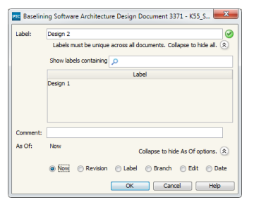
Baselining a Document
1. For the document you want to baseline, do one of the following:
• Open the document in the Document view.
• Select the document from an applicable view or field, for example, the Items view or a relationship field.
2. Select Document ▶ Baseline. The Baseline dialog box displays.
3. Type the name of the Label for the baseline, for example, Design 2. The specified label name must be unique (not already used for the Selected document). If the label name already exists, a red X icon displays and the name must be changed before you can complete the baseline. A green check mark icon displays when a unique label name is specified
TIP:
To make it easier to find a unique label name,
click the Expand to view all button to display a list of existing
label names as shown.
Contd..

Slide 14
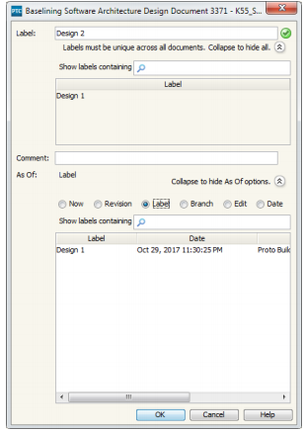
Baselining a Document
4. Select the applicable As Of option from the list. The default option is Now, indicating the current date and time. If you are baselining a historical item, the associated date and time displays by default in the As Of field.
Further, As Of field will have the following options: ₋
-Now – Current Time and Date
-Revision – List of revisions of the document
₋Label – List of labels (Baselines) of the document
₋Branch – List of branches of the document
₋Edit – History of all the edits with modified timestamp
₋Date – Calendar to select date of the document
Contd..

Slide 15
As Of options for Baselining a Document
To baseline a document As Of... | Do this...
Now | Select Now to baseline the current version of the document
Revision | This option is only available if you are baselining a document that allows versioning. Select Revision. A list of all the labels associated with revisions displays. The labels use the format major. minor. Select the revision that corresponds to the time you want to create the baseline as of.
Label | Select Label. A list of all the labels on the document displays. Select the label that corresponds to the time you want to create the baseline as of.
Branch | Select Branch. A list of all the branches associated with the document displays. Select the branch that corresponds to the time you want to create the baseline as of.
Edit | Select Edit. A list of all the dates at which the document item was significantly modified displays. Select the date that corresponds to the time you want to baseline as of.
Date | Select Date. This option allows you to select an arbitrary date for the baseline using the calendar, select the date that corresponds.

Slide 16
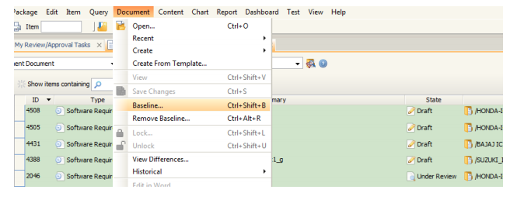
Baseline multiple documents
For the documents you want to baseline, select the documents from an applicable view or field, for example, the Items view or a relationship field
Select Document ▶ Baseline. The Baseline dialog box displays.
Type the name of the Label for the baseline, for example, Project ABC System.
Contd..

Slide 17
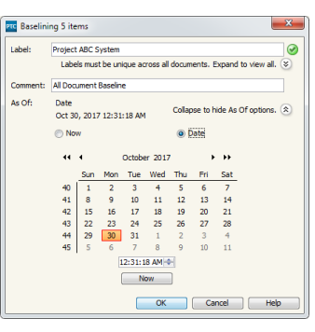
Baseline multiple documents
Select the applicable As Of option from the list. The default option is Now, indicating the current date and time
To baseline a document As Of... | Do this...
Now | Select Now to baseline the current version of the document.
Date | Select Date. This option allows you to select an arbitrary date for the baseline using the calendar, select the date that corresponds. Note: The date selected must not precede the most recent created date of the selected documents.
Contd..

Slide 18
Removing Baselines From Documents
A baseline is a special label added to documents that captures a meaningful point in the document’s history. Typically, PTC does not recommend removing a baseline; however, you may want to remove a document baseline if you want the baseline label to refer to a new date and time.
To remove a baseline, select the documents containing the baseline you want to remove. If you select more than one document, you can only remove baselines that are common to all the selected documents. This means that only baseline labels containing the same name across all the selected documents can be removed at once.
Key Considerations
  Your Integrity administrator determines who can create baselines by configuring the rules associated with removing labels on your document type.
  If you specify a node in the remove baseline operation, the operation is applied to the document that node is contained in.
Contd..

Slide 19
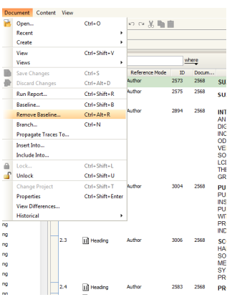
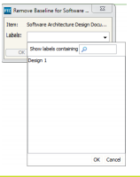
To remove a baseline from a document
For the document you want to remove a baseline from, do one of the following:
  Open the document in the Document view.
  Select the document from an applicable view or field, for example, the Items view or a relationship field.
Select Document ▶ Remove Baseline.
The Remove Baseline dialog box displays.
From the Labels list, select the name of
the baseline label you want to remove.
Only labels associated with a baseline are
available for selection.
Click OK.
Contd..

Slide 20
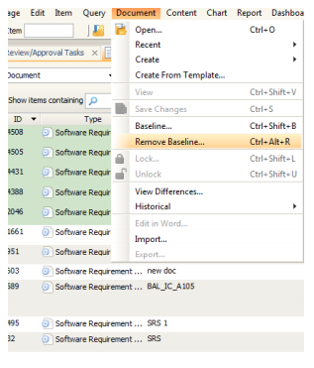
To remove a baseline from all document
For the documents containing the baseline you want to remove, select the documents from an applicable view or field, for example, the Items view or a relationship field.
Select Document ▶ Remove Baseline. The Remove Baselines dialog box displays.
From the Labels list, select the name of the
baseline label you want to remove. Only
labels containing the same name across
all selected documents are available for
selection.
Click OK.
Contd..

Slide 21
Comparing Documents
Compare content and field-level differences between two document selections using the Document Difference view.
For example, user can select a requirements document with two baseline labels and relevant fields of interest to see how the document has changed over time.
The view presents structural and content changes side-by-side in two document panes. Item and field additions, deletions, moves, changes, as well as text differences are highlighted.
User can use navigation tools to efficiently review and navigate the document differences

Slide 22
Key Considerations for Field Selections
The primary text field is always compared.
You can only compare content fields that are relevant to the content type for the selected document type. Supported field types for comparison include the following types: long text, rich text, short text, Picklist, attachment, category, trace relationship, integer, floating point, state, logical, date, FVA to long text, FVA to rich text, FVA to short text, FVA to picklist, FVA to attachment, FVA to integer, FVA to floating point, FVA to logical, and FVA to date. Unsupported field types may contain differences; however, the document comparison algorithm ignores differences in unsupported field types.
Except for the text field, any field you do not choose to compare may contain differences; however the document comparison algorithm ignores differences in fields that are left out of the document comparison.

Slide 23
Selecting Documents to Compare
  You can specify the following types of document selections:
    One document at two different points in time.
    Two versions of the same document (and optionally at different points in time).
    Two branched documents that share a common branch ancestor item ID (and ▪ optionally at different points in time). For example, you can compare a versioned document to a document that was branched.
  To access the Document Difference view in the GUI, select Document ▶ View Differences.
  The steps for comparing documents includes the following steps:
    Select documents to compare.
    Select fields to compare.
    Filter comparison results in the view
    Review document differences.

Slide 24
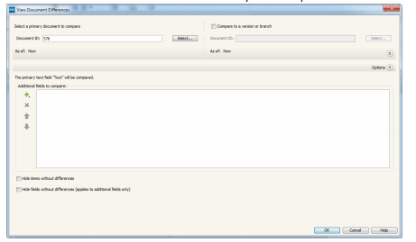
Selecting Documents to Compare
Selecting Fields to Compare
Expand Options and select the content fields you want to compare:
  specifies fields to add to the Additional fields to compare list. You can filter the list of fields.
  removes selected fields from the Additional fields to compare list.
  adjusts the order in which the fields display in the Document Difference view.
Click OK. Your field selections are remembered the next time you compare documents of the same document type.
Contd..

Slide 25

Types of Document Differences
Type of Document Difference | Highlight/ Connector Arrow Color | Interface Icon
Added content An item that is not present in the source document but is present in the target document. A placeholder offers a visual indication of where the addition was made in the source document | Green

Slide 26
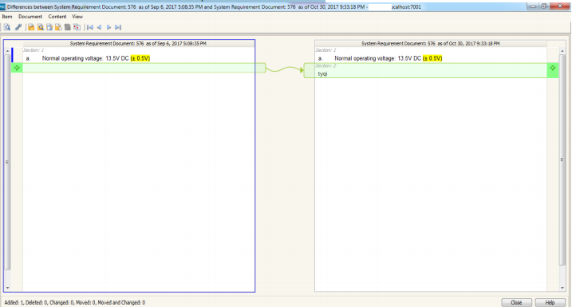
View Differences – Comparison Indicators
Green Link indicates new content has been added compared to first document.

Slide 27
Types of Document Differences
Type of Document Difference | Highlight/ Connector Arrow Color | Interface Icon
Deleted content An item that is present in the source document but is not present in the target document. A placeholder offers a visual indication of where the deletion was made in the target document. | Red

Slide 28
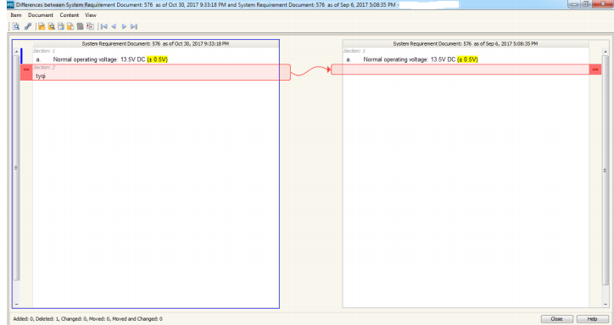
View Differences – Comparison Indicators
  Red Link indicates content is missing compared to first document.

Slide 29

Types of Document Differences
Type of Document Difference | Highlight/ Connector Arrow Color | Interface Icon
Modified content Any non-structural change to item or field content. | Yellow

Slide 30
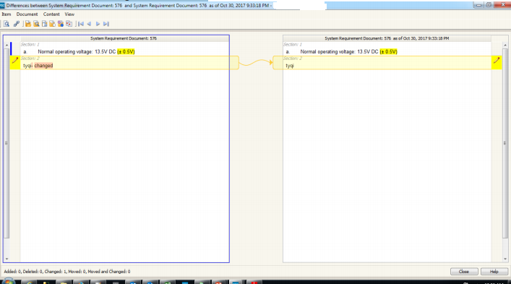
View Differences – Comparison Indicators
  Yellow Link indicates that text has been changed since last edit.

Slide 31


Types of Document Differences
Type of Document Difference | Highlight/ Connector Arrow Color | Interface Icon
Moved content An item present in both the source document and target document that: has a different parent has the same parent but is in a different relative position has a parent that has been moved. | Blue
Moved and modified content | Blue and Pencil

Slide 32
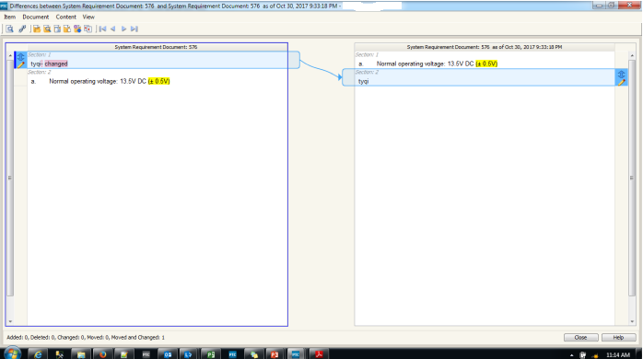
View Differences – Comparison Indicators
  Blue Link indicates that content has been moved.

Slide 33
Navigating Document Difference
You can navigate incrementally through each difference in the current document pane using View menu options, or by using the following toolbar or shortcut key options:
  Previous difference: or press F7
  Next difference: or press F8
  First difference: or press CTRL+F7
  Last difference: or press CTRL+F8
Select View ▶ Wrap Difference Search to configure the Previous and Next difference search options to wrap to the top or bottom of the document pane.
Clear the Wrap Difference Search option to stop at the beginning or end of the document pane.

Slide 34
Navigating the Document Pane
The following document pane keyboard navigation options are available in the Document Difference view for the current document pane.
CTRL+TAB | Switches the focus to the other document pane.
TAB | Selects the next field.
UP arrow key | Selects the previous row header.
DOWN arrow key | Selects the next row header.
HOME | Selects the first row header.
END | Selects the last row header
SPACEBAR | Selects the row header icon in focus and moves to the corresponding difference in the other document pane.
PAGE UP | Scrolls up approximately one page.
PAGE DOWN | Scrolls down approximately one page.

Slide 35
Creating a Checklist Document Method 1

Slide 36
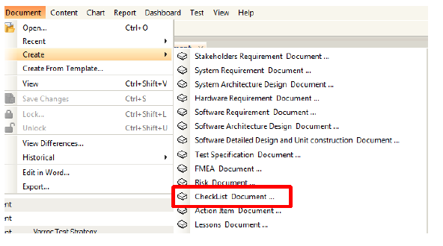
Creating and Managing Documents – Method 1
Select Create Document menu to create a new document in Integrity.
Steps:
1.Creating Checklist document
2.Select Appropriate Project
3.Editing data in Item view
4.Auto-populated & Multi-select fields
5.Applying changes in created document
6.Document view
7.Creating/Editing contents

Slide 37
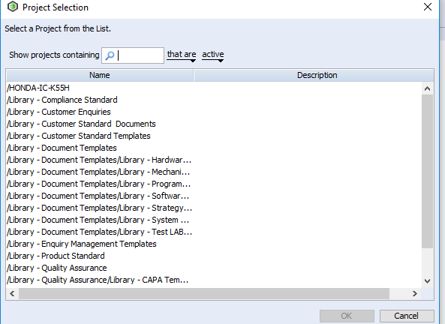
Creating and Managing Documents – Method 1
Select a project under which document needs to be created then Click “OK” button.
Steps:
1.Creating Checklist document
2.Select Appropriate Project
3.Editing data in Item view
4.Auto-populated & Multi-select fields
5.Applying changes in created document
6.Document view
7.Creating/Editing contents

Slide 38
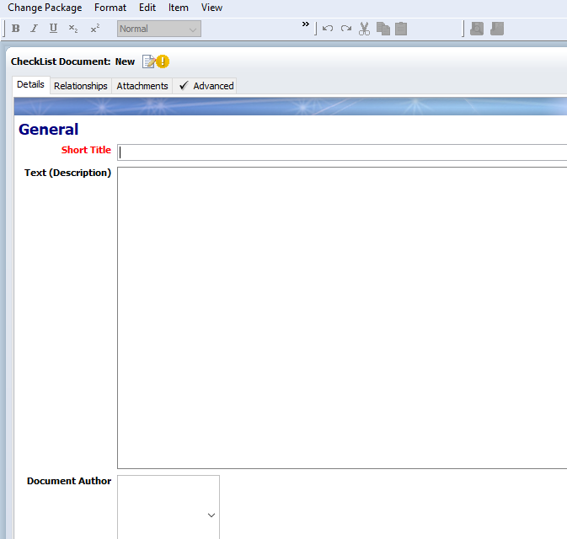
Creating and Managing Documents – Method 1
Document item view will open up. Enter or select correct values for the fields present. Project field will be populated as per selection in step 2.
Fields Short Title and Project marked red are mandatory fields and must be filled.
Steps:
1.Creating Checklist document
2.Select Appropriate Project
3.Editing data in Item view
4.Auto-populated & Multi-select fields
5.Applying changes in created document
6.Document view
7.Creating/Editing contents

Slide 39
Creating and Managing Documents – Method 1
Author field is automatically populated so need not to be filled.
Select appropriate field values (one or multiple) for the rest of the fields.
State field is automatically transited until Published state of document.
Steps:
1.Creating Checklist document
2.Select Appropriate Project
3.Editing data in Item view
4.Auto-populated & Multi-select fields
5.Applying changes in created document
6.Document view
7.Creating/Editing contents

Slide 40
Creating and Managing Documents – Method 1
All other fields visible in the Document Item view must be filled.
Fields that are not editable will be editable depending on the state of the document it is in.
Clicking on “Apply” will keep the user on the same screen while clicking on “OK” will open the document view window.
Clicking “Apply” will save the document. Alternately “Ctrl + S” can also be used.
After all fields are filled, Click “OK” button to create the document.
Steps:
1.Creating Checklist document
2.Select Appropriate Project
3.Editing data in Item view
4.Auto-populated & Multi-select fields
5.Applying changes in created document
6.Document view
7.Creating/Editing contents

Slide 41
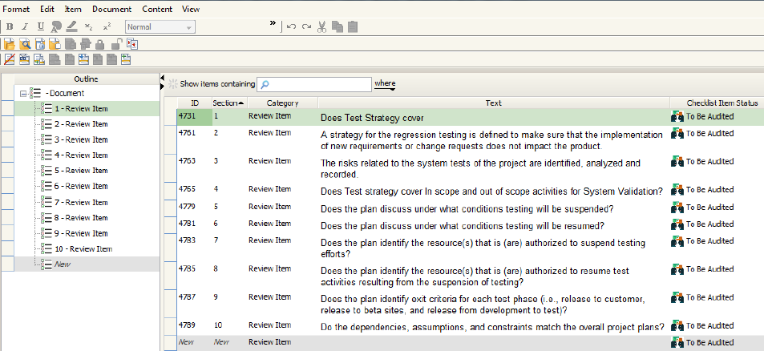
Creating and Managing Documents – Method 1
As soon as you click “OK” in item view, you will be navigated to “Document View Window”.
If the document is newly created, the user must populate it with content in the line items provided.
Steps:
1.Creating Checklist document
2.Select Appropriate Project
3.Editing data in Item view
4.Auto-populated & Multi-select fields
5.Applying changes in created document
6.Document view
7.Creating/Editing contents

Slide 42
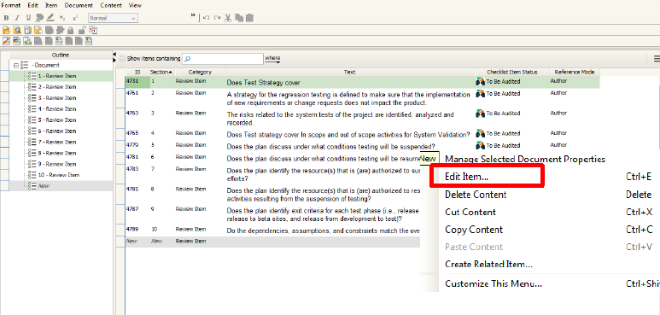
Creating and Managing Documents – Method 1
User can create content by clicking on the line item and type the title in the text and then right click on it and select “Edit Item”. Fill required details. Click on “OK”.
Steps:
1.Creating Checklist document
2.Select Appropriate Project
3.Editing data in Item view
4.Auto-populated & Multi-select fields
5.Applying changes in created document
6.Document view
7.Creating/Editing contents

Slide 43
Creating a Checklist Document Method 2

Slide 44
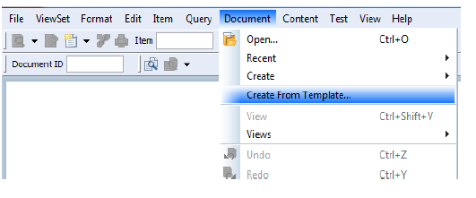
Creating and Managing Documents –Method 2
Select Create From Template in the Document feature to create any document into Integrity from existing Project or Library.
Steps:
1.Creating document from template
2.Finding the template
3.Select Project
4.Editing data in Item view
5.Auto-populated & Multi-select fields
6.Applying changes in template
7.Document view of template
8.Editing contents

Slide 45
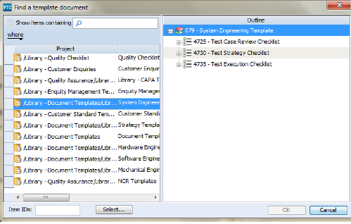
Creating and Managing Documents –Method 2
Select the document, desired to be created from the list displayed in the dialog box then Click “OK” button.
Steps:
1.Creating document from template
2.Finding the template
3.Select Project
4.Editing data in Item view
5.Auto-populated & Multi-select fields
6.Applying changes in template
7.Document view of template
8.Editing contents

Slide 46
Creating and Managing Documents –Method 2
Select a project under which document needs to be created then Click “OK” button.
Steps:
1.Creating document from template
2.Finding the template
3.Select Project
4.Editing data in Item view
5.Auto-populated & Multi-select fields
6.Applying changes in template
7.Document view of template
8.Editing contents

Slide 47
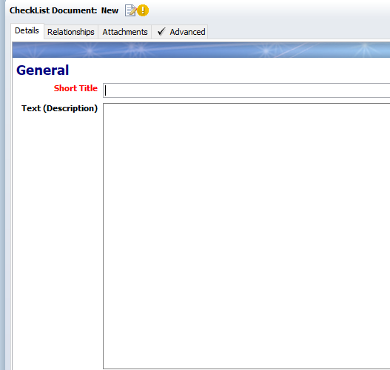
Creating and Managing Documents –Method 2
Document item view will open up. Enter or select correct values for the fields present. ID will be created before clicking Apply or OK.
Fields Short Title and Project marked red are mandatory fields and must be filled.
Steps:
1.Creating document from template
2.Finding the template
3.Select Project
4.Editing data in Item view
5.Auto-populated & Multi-select fields
6.Applying changes in template
7.Document view of template
8.Editing contents

Slide 48
Creating and Managing Documents –Method 2
Author field is automatically populated so need not to be filled.
Select appropriate field values (one or multiple) for the rest of the fields.
State field is automatically transited until Published state of document.
Steps:
1.Creating document from template
2.Finding the template
3.Select Project
4.Editing data in Item view
5.Auto-populated & Multi-select fields
6.Applying changes in template
7.Document view of template
8.Editing contents

Slide 49
Creating and Managing Documents –Method 2
All other fields visible in the Document Item view must be filled.
Fields that are not editable will be editable depending on the state of the document it is in.
Clicking on “Apply” will keep the user on the same screen while clicking on “OK” will open the document view window.
Clicking “Apply” will save the document. Alternately “Ctrl + S” can also be used.
After all fields are filled, Click “OK” button to create the document.
Steps:
1.Creating document from template
2.Finding the template
3.Select Project
4.Editing data in Item view
5.Auto-populated & Multi-select fields
6.Applying changes in template
7.Document view of template
8.Editing contents

Slide 50
Creating and Managing Documents –Method 2
As soon as you click “OK” in document item view, you will be navigated to “Document View Window”.
If the document is created from template it will auto populated with template's data. Data must be updated with project-specific data.
Steps:
1.Creating document from template
2.Finding the template
3.Select Project
4.Editing data in Item view
5.Auto-populated & Multi-select fields
6.Applying changes in template
7.Document view of template
8.Editing contents

Slide 51
Creating and Managing Documents –Method 2
If the document is created from template it will auto populated with template's data. Data must be updated with project-specific data.
Steps:
1.Creating document from template
2.Finding the template
3.Select Project
4.Editing data in Item view
5.Auto-populated & Multi-select fields
6.Applying changes in template
7.Document view of template
8.Editing contents

Slide 52
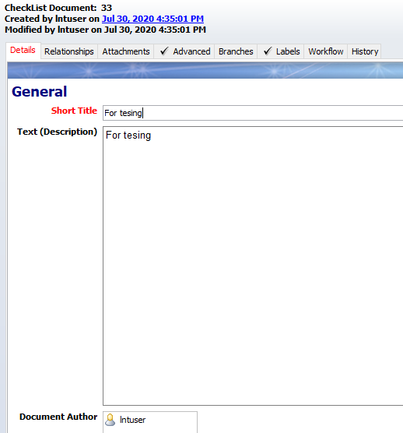
Checklist Document – Details Tab
The Details tab contains two sections, namely:
₋General
₋Details
General section contains field like Short Title, Description and Document Author (Auto-fills Current User after pressing Apply).
Details section contains State, Project and Comments fields.

Slide 53
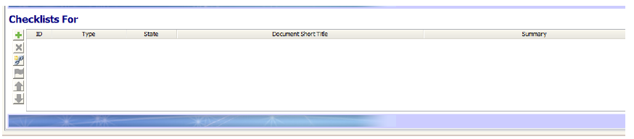
Checklist Document – Relationships Tab
Relationship Tab of checklist includes fields that are linked and inter-related to Checklist Document.
“Documents” field displays the Libraries or Projects that includes that particular Checklist Document.
“Contains” field list downs all the Checklist contents that are present within the same document.
The item for which the Checklist Document is created should be attached in “Checklist List For” relationship field.
Example shown below:

Slide 54
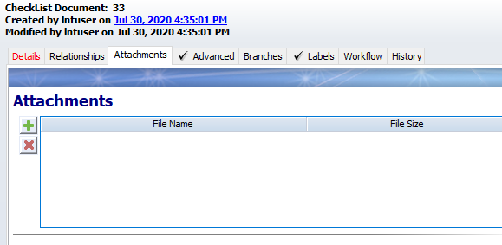
Checklist Document – Attachments Tab
As the name suggests, any kind of file that is related to the Checklist Document can be attached in this field.
The file could be a word document, pdf, jpeg, etc. that describes the Checklist Document.
The Maximum file size that can be attached is 5 MB.

Slide 55
Checklist Document – Advanced Tab
Advanced Tab shows the document metrics that technically describes the document.
Fields mentioned are auto-computed:
₋All Content Count
    The number of content items in this segment. This document metric is calculated once a day via the Daily Metrics trigger.
₋Meaningful Content Count
    The number of meaningful items in this segment. This document metric is calculated once a day.

Slide 56
Checklist Workflow [content]

Slide 57
Details Tab of Checklist Content
Firstly, user need to enter description i.e. the right statements and questions needed to complete the Checklist.
The content of Checklist is “Review Item” (Category) by default.
User can also use “Heading” and “Comment” category to organize the document.
“Checklist Item Status” is the value selected to display the status of the Review Item entered. It is divided as below:
₋Compliant
₋Non-Compliant
₋Not Applicable
₋To Be Audited
₋Partially Compliant
“Assigned Reviewer” field needs to be entered in order to review the “Review Item” made in Checklist Document.
Finally, “Comments” field is provided for Assigned User and Reviewer to write appropriate comments regarding the Review Item.

Slide 58

Thank you
Thank you

